Slide 1
Power Plant Floor Drill guide
Joseph Burden 5/16/2021

Slide 2
!st floor (Base), 10.187” x 39.187 note the top side
2nd floor and roof, 10.062” x 39.000
note the top side of both pieces
2nd floor and roof superimposed on base

Slide 3
2nd floor and roof superimposed on base
This edge should have a even spacing around 0.125
”
This edge should have a even spacing on both sides around 0.062”
Tape the clear roof section flush to the underside of the 2nd floor flush on all sides (ends).
Than place this over the wider base, center it and tape too prevent movement

Slide 4
2nd floor and roof superimposed on base
0.437”
This edge should have a even spacing around 0.125”
This edge should have a even spacing on both sides around 0.062”
Mark and locate the 4 corner locations. Carefully drill one #33 (0.113”) hole at each corner. Remove the tape from all pieces than install 4 each # 4 screws with flat washers andlock nuts at each corner
0.312”

Slide 5
2nd floor and roof superimposed on base
Locate the 2 Horizontal holes inline with the side rafter positions approximately 6.5” apart. Note the two end locations must be at the locations in sheet 4
Locate the 4 vertical holes inline with the rafter positions approximately 6.5” apart. Note the two end locations must be at the locations in sheet 4

Slide 6
2nd floor and roof superimposed on base
Drill 12 each #33 holes at the intersections without screws
Drill 8 each #33 holes at the intersections without screws or holes

Slide 7
Final Base Configuration
Drill 24 each #19 (0.166”) holes at all the #33 hole locations
Insert the PEM inserts thru the bottom of the base to ensure proper alignment. Press into position using the tooling supplied by Joe Burden

Slide 8
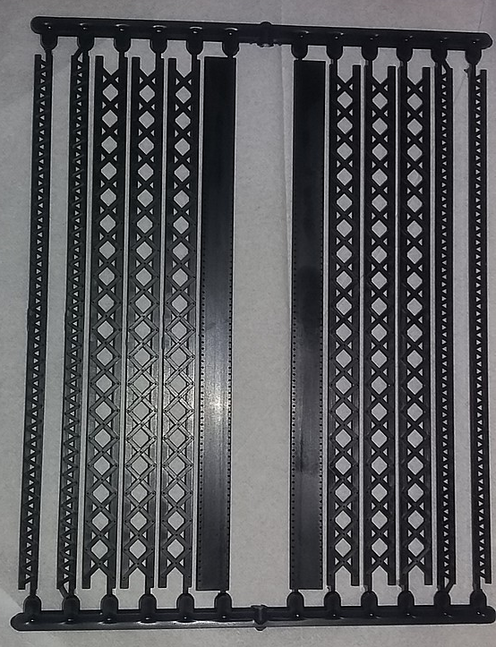
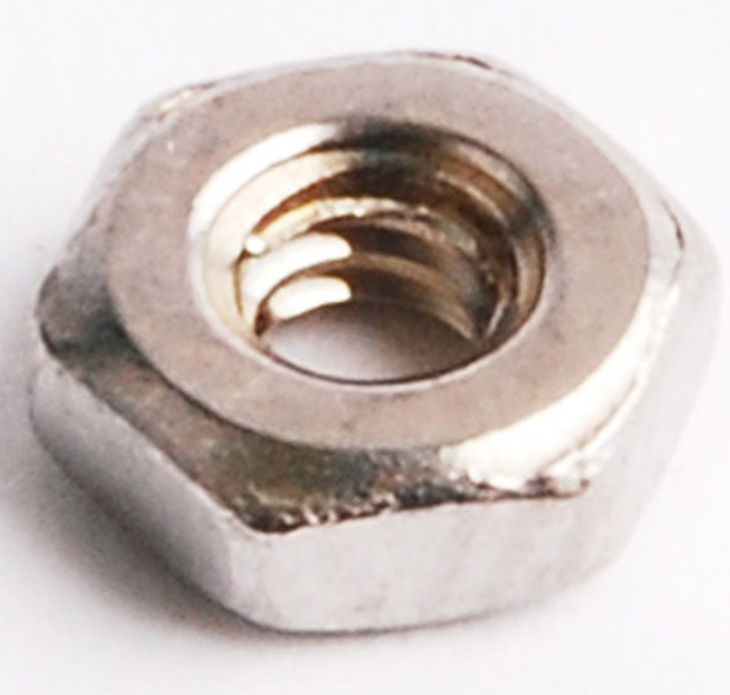
Central Valley small girder set, select a size that will cover the small diameter nuts
PER CMR,
they recommend the following adhesive for the power plant interior models. We recommend using Scalecoat Probond.

Slide 9
Order for turbine and condensers with floors and railings
Custom Model Railroads - Kits
1120 East 30th Street
Baltimore Md 21218
Joseph Burden Deliver To:
Metrolina Model Railroaders club Metrolina Model Railroaders
11927 Creek Turn Dr. 11927 Creek Turn Dr.
Charlotte, NC 28278 Charlotte, NC 28278
Date: 07/24/2017 Number: 170713332 Account Number: 2756
Payment Terms: Credit Card - MC/Visa
Reference:
Quantity 4
Turbine Casting - HO
2 Floor, condenser and stairs with railings. 30.00 T 60.00
2 Complete Overhead Traveleing Crane and Hoist Assembly 20.00 T 40.00
1 Shipping rate $151-$449 24.00 24.00
Total: $224.00
Sales Tax: $0.00
Grand Total: $224.00
Paid Amount: $0.00 Balance Due: $224.00

Slide 10
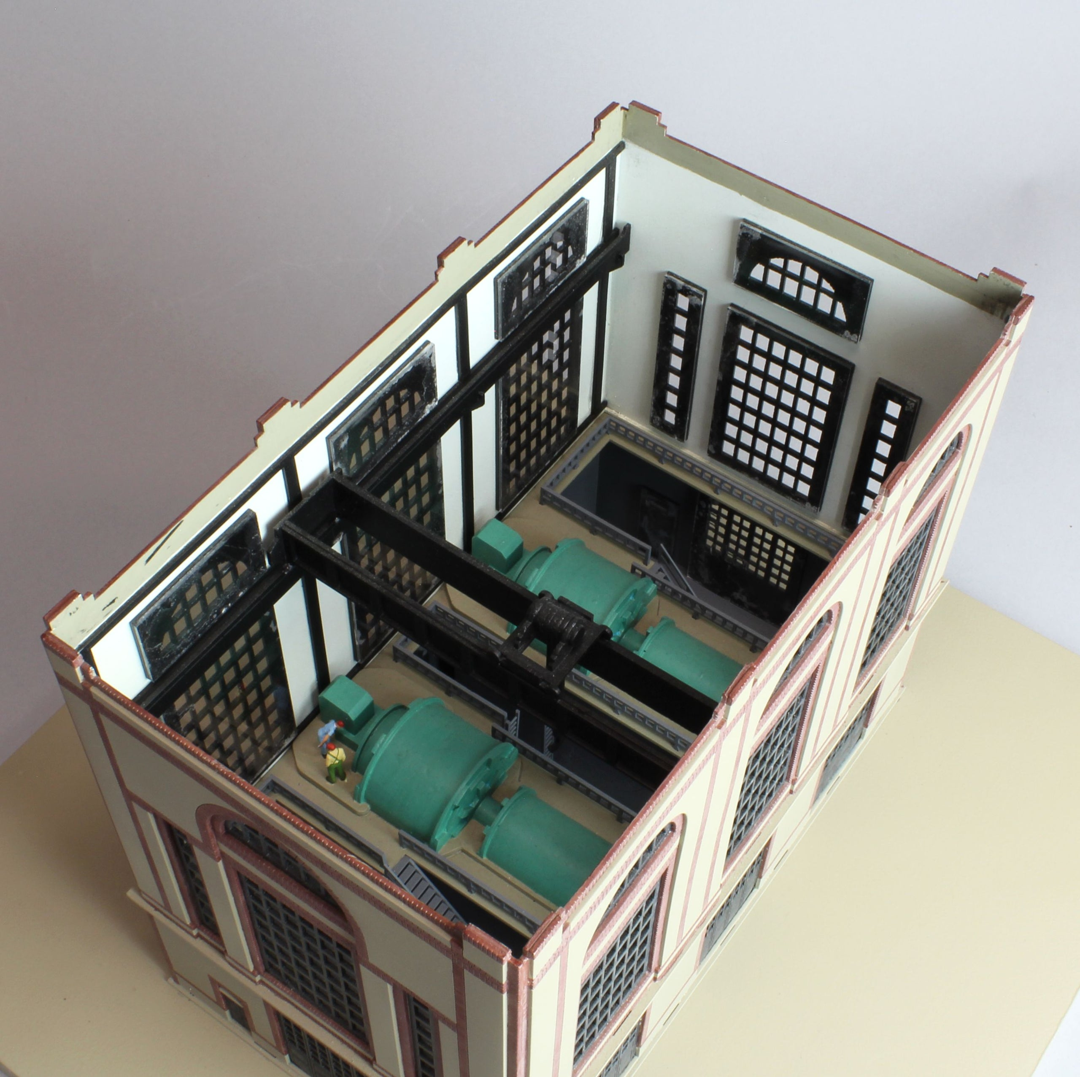
This is a drawing of the CMR turbine drawing that includes the parts I purchased for the turbines in our model see the Turbine building assembly PDSF for assembly instructions.
Turbine purchased needs painting , it has a condenser unit under it the kit includes the 2nd floor section and stairs with railings

Slide 11
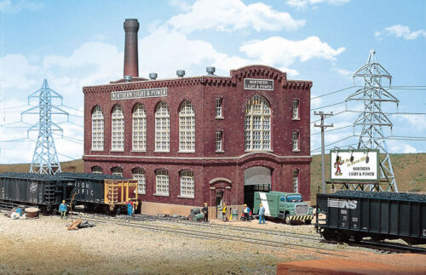
The New MMRR power plant is a kit bashed plant assembly consisting of 2 Walthers Northern Light Power Plant kits. The base, 2nd floor and roof are Aluminium composit sheets custom made for the bldg. Our design has no front facing wall to allow viewers to see the interior details
I believe we should have two boiler rooms as show to power the 4 turbines. The drawing shown are part of the Walthers Champion Packing Plant – Kit. We will also require detailed plumbing, control room and electronics I put some diagrams on the club computer at the POWER PLANT folder

Slide 12
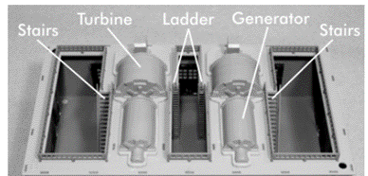
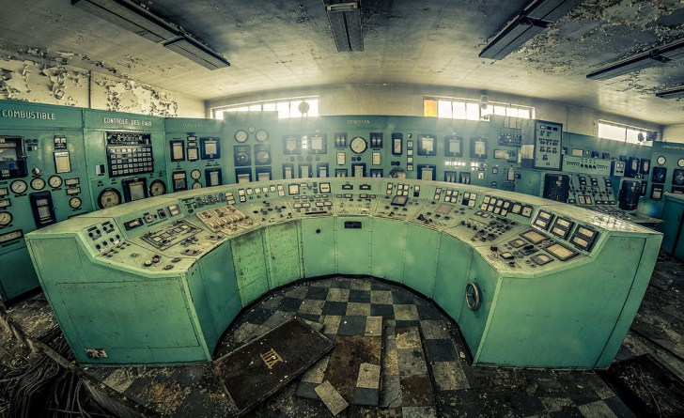
Second floor view with trusses above for Roof and below 2nf floor
Roof top View with trusses shown
Do we want horizontal trusses also?
SHAPEWAYS does have a large selection of control panels in HO scale. None have been purchased as of today An option is to make the control stations using styrene with paper markings as I did for a sample.

Slide 13
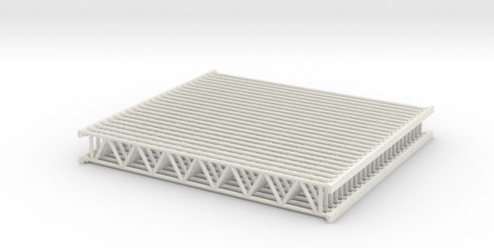
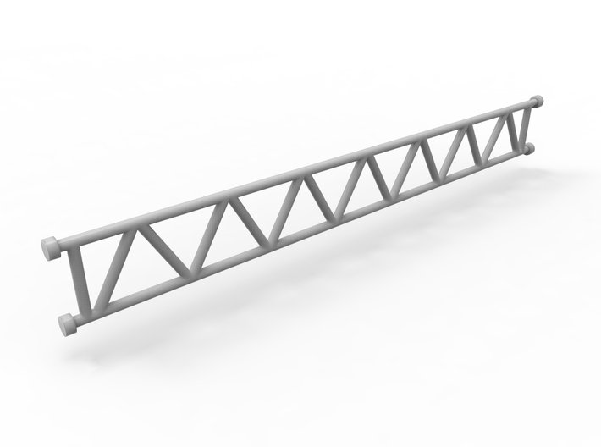
Set of 24 Lattice girders in HO Scale (1:87)
Each individual girder measure in 1:1 scale 500mm x 4878mm
Shapeways product made by pinelas
2.26 x 2.02 x 0.28 inches

Slide 14
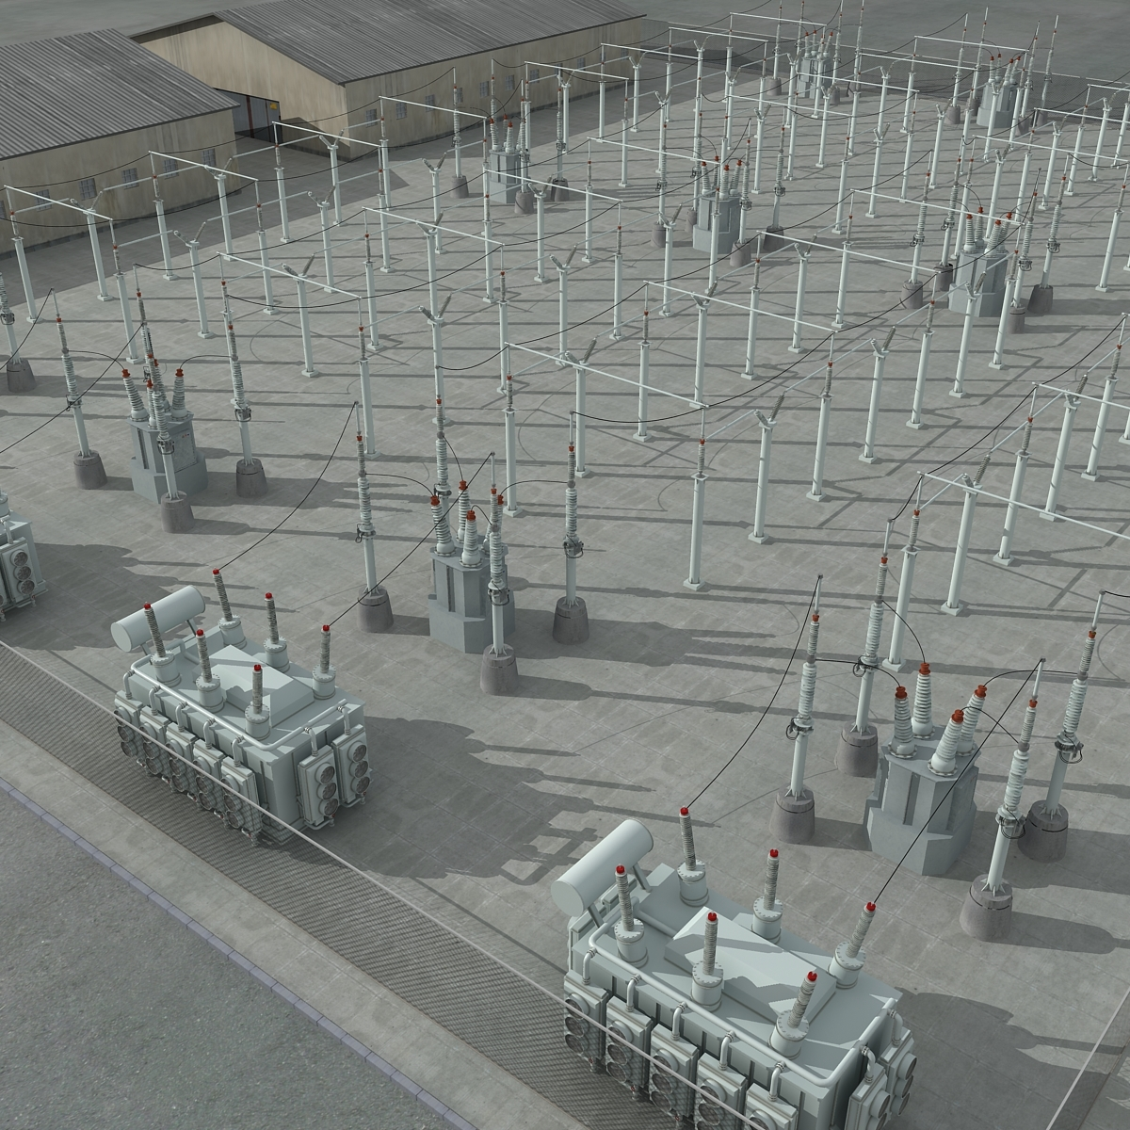

Slide 15
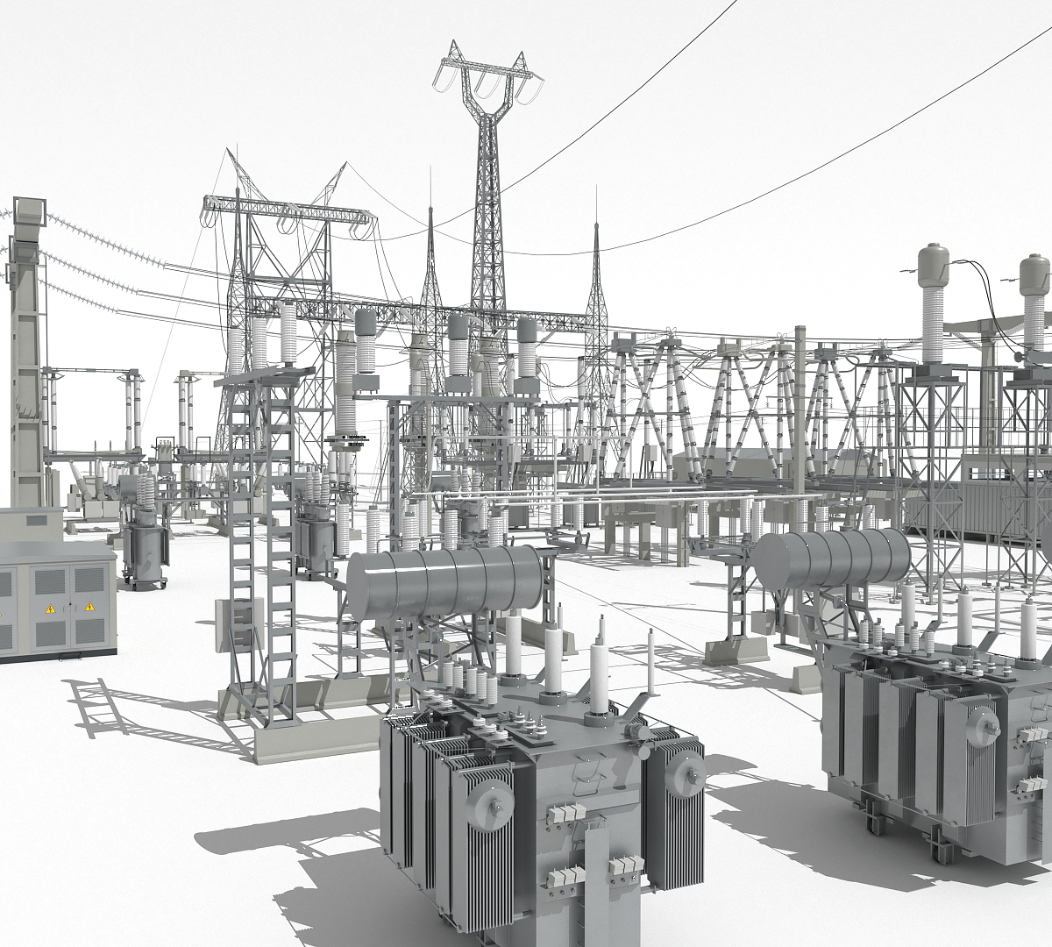

Slide 16
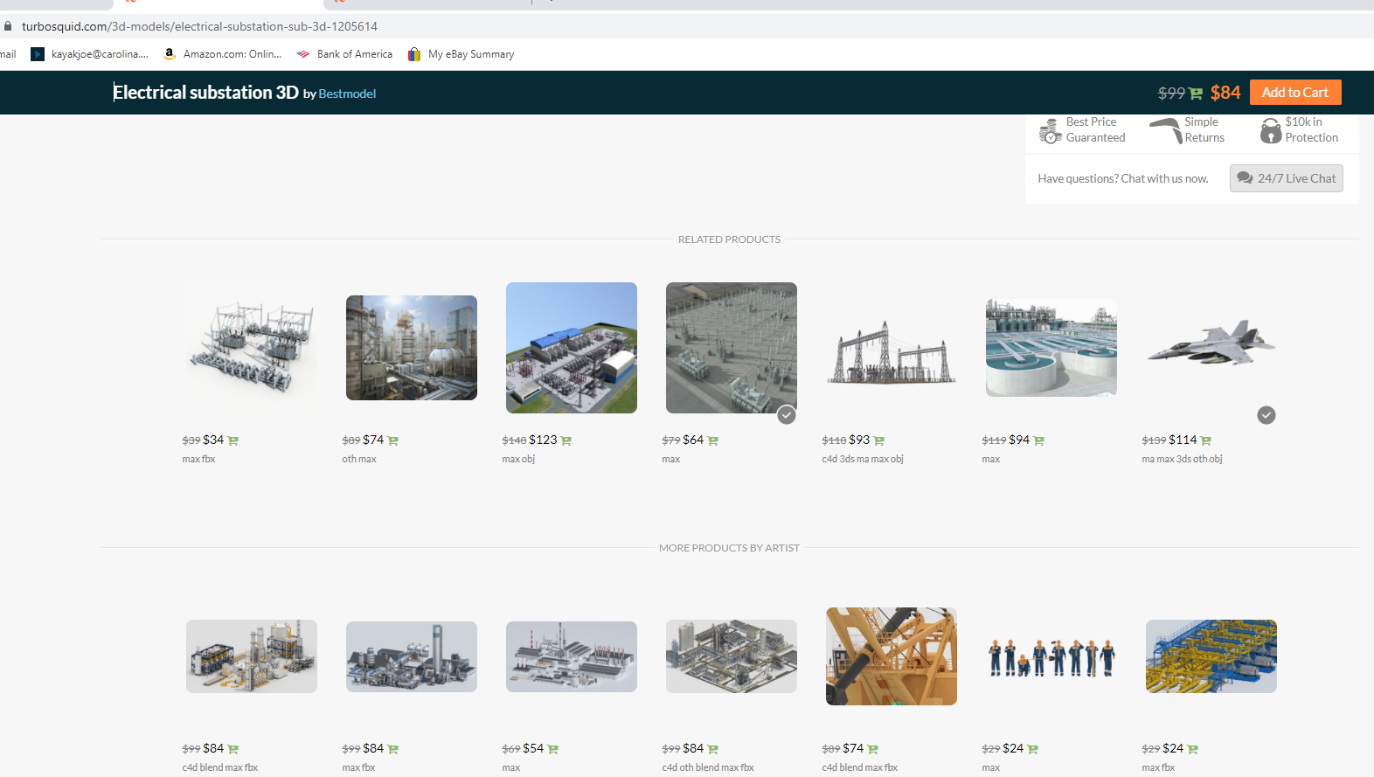
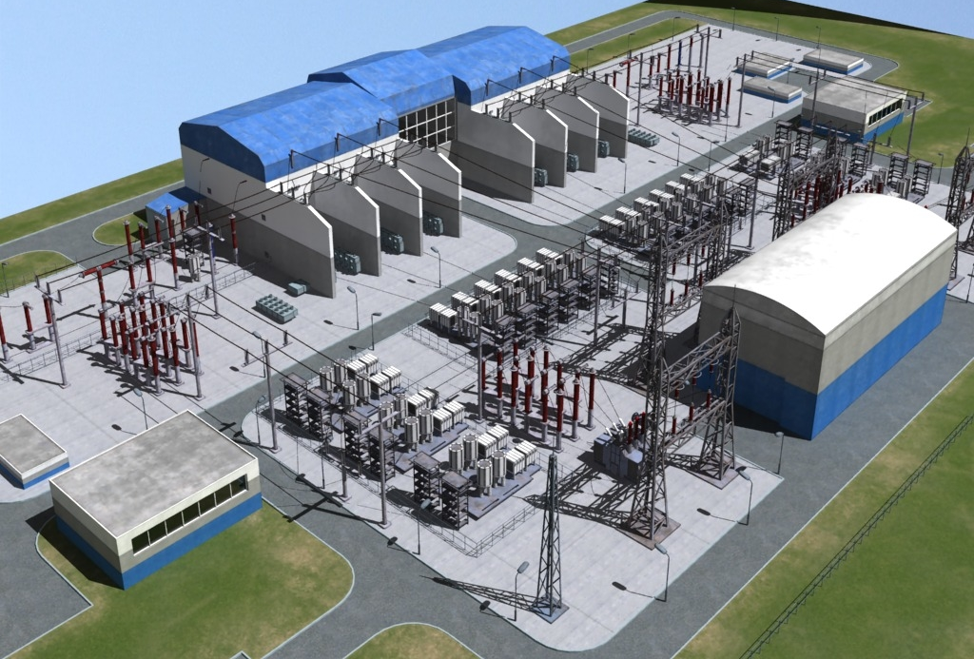

Slide 17
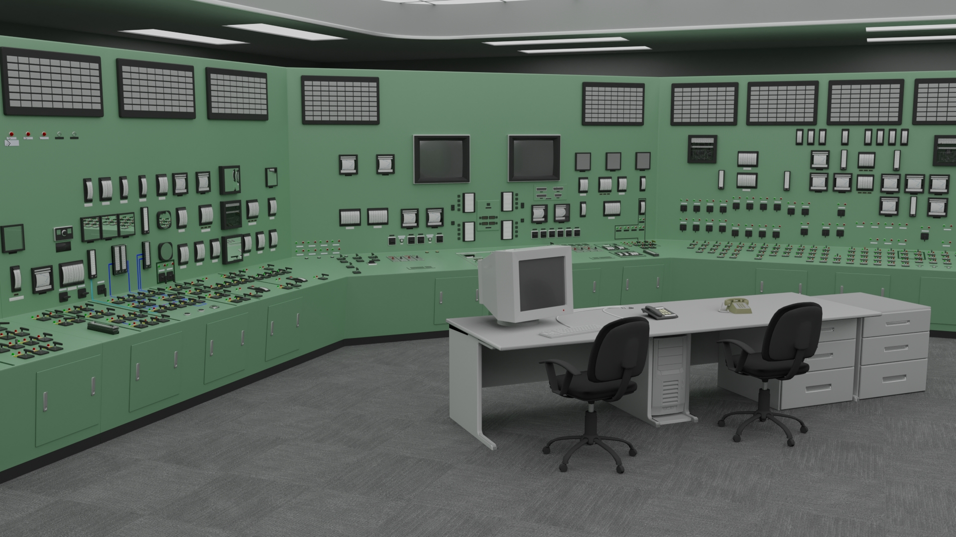
3D Fukushima Daiichi nuclear power plant control room
by Dacian_Falx
$50 $35
3D Model License: Standard
Editorial Uses Only
FORMATS
NATIVE
Blender 2.92 | Cycles Render 2.92
Free file format Conversions available
3D MODEL SPECIFICATIONS

Slide 18
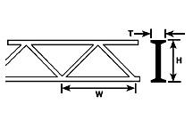
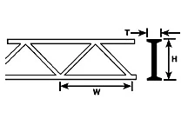
OWTS-12
Regular price
$4.10
3/8" STYRENE WARREN OPEN WEB TRUSS
Quantity 1
Adding product to your cart
Description
Color: WHITE
Scale: ALL
Use Description: STYRENE OPEN WEB TRUSS - WARREN STYLE 2 Use for roof trusses, bridges, conveyors, space frames and other steel structures. Precision Injection Molded in White Styrene Plastic. Ideal when assembly spee
Height in Inches: 3/8"
Height in MM: 9.5mm
Length in Inches: 6"
Length in MM: 150mm
Width in Inches: 5/8"
Width in MM: 15.9mm
Material: STYRENE
Thickness in Inches: 11/64"
Thickness in MM: 4.4mm

Slide 19
OWTS-8
OWTS-8 Regular price $3.60
1/4" STYRENE WARREN OPEN WEB TRUSS
Quantity 1
Adding product to your cart
Description
Color: WHITE
Scale: ALL
Use Description: STYRENE OPEN WEB TRUSS - WARREN STYLE 2 Use for roof trusses, bridges, conveyors, space frames and other steel structures. Precision Injection Molded in White Styrene Plastic. Ideal when assembly spee
Height in Inches: 1/4"
Height in MM: 6.4mm
Length in Inches: 6"
Length in MM: 150mm
Width in Inches: 3/8"
Width in MM: 9.5mm
Material: STYRENE
Thickness in Inches: 1/8"
Thickness in MM: 3.2mm

Slide 20
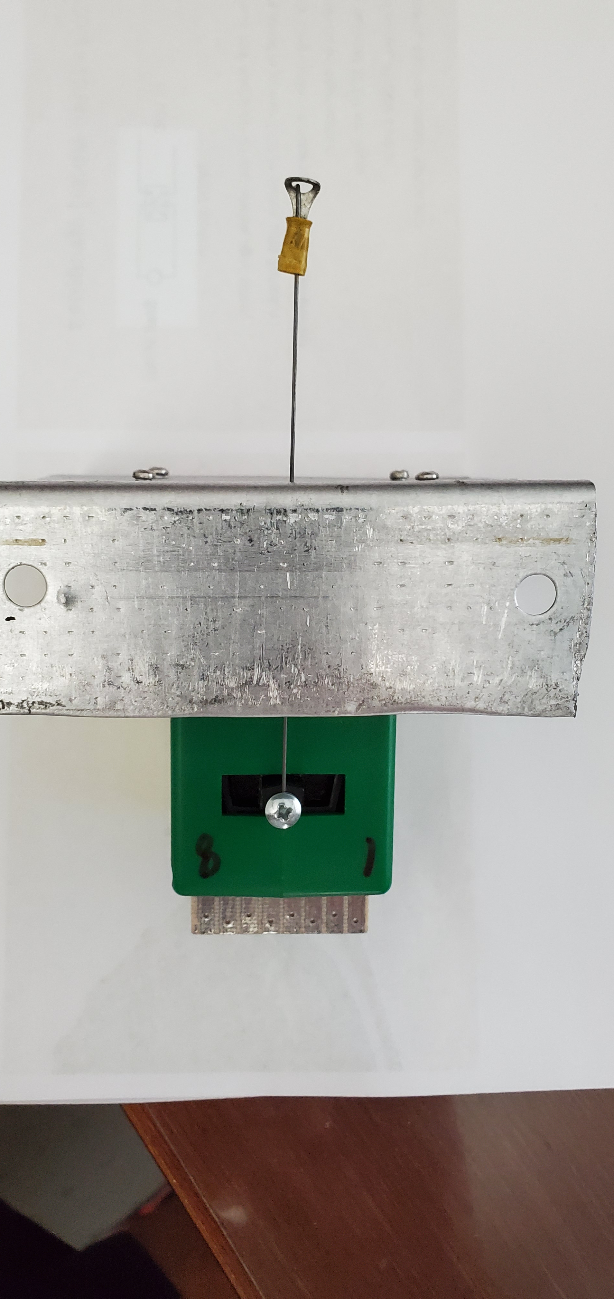
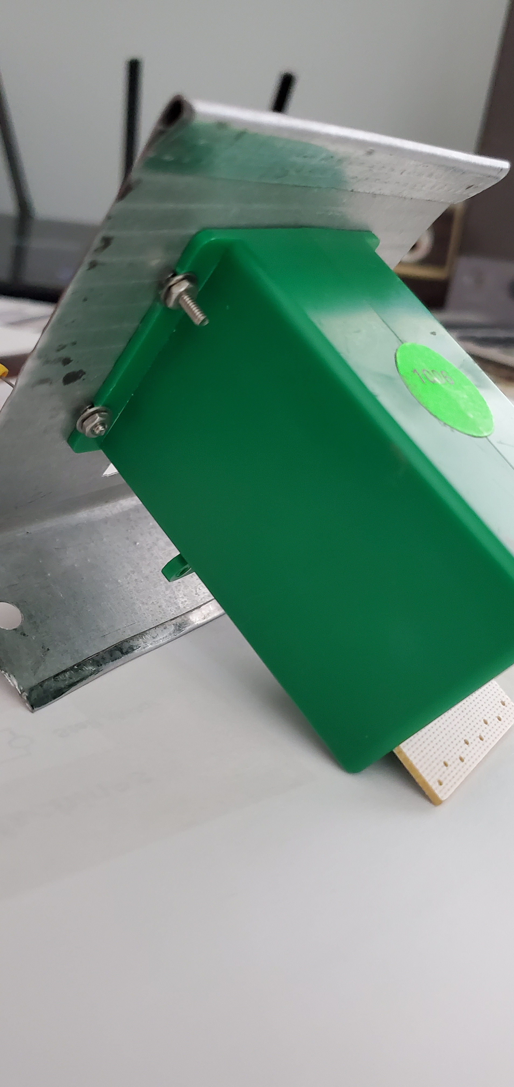
Mounting the Totrtoise motor to the right angle bracket

